Slide 1



NVDLA SDP Architecture
Cong Liu
16/11/2007

Slide 2
Architecture

Slide 3
BS/BN
Alexnet conv5 relu5
ALU
input [511:0] 16 x 32 bit
output [527:0] 16 x 33 bit
33 bit:
0 1:22 23:26 27:30 31:32
MUL
input [527:0] 16 x 33 bit
output [799:0] 16 bit + 16 x 49 bit
49 bit:
0:9 10:12 13:22 23:26 27:28 29:30 31:48
[799:784] = ~(符号位 | prelu)
TRT （精度调整和pRElu）
input [799:0] 16 bit + 16 x 49 bit
output [511:0] 16 x 32 bit
32 bit：
0 1:30 31
bypass
bypass
RELU
input [511:0] 16 x 32 bit
output [511:0] 16 x 32 bit
>>21

Slide 4
EW CVT
EW
input [511:0] 16 x 32 bit
output [511:0] 16 x 32 bit
pack:
CVT
input [511:0] 16 x 32 bit
output [272:0] 16+16 x 16 bit
X * scale + bias
convert to 16 bit data
16 points respectively
bypass

Slide 5
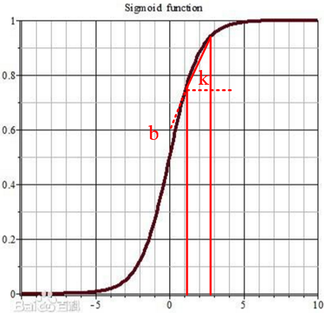

LUT
sigmoid $=kx+b$

Slide 6
Float to Fixed
The shift value (a+b-c) should be configured to DLA

Slide 7
Thank you !
Discussion

